Slide 1
PNEUMONIA LUNGS DISEASE PREDICTION USING DEEP LEARNING

Slide 2
SRUJANA KONDA – 700740479
REVANTH BHARADWAJ TR – 700743276
TEJASWI REDDY MARRI -700742730
SAI PAVAN REDDY POGULA - 700741739

Slide 3
CONTENTS
MOTIVATION
OBJECTIVES
CONTRIBUTION
RELATED WORKS
PROBLEM STATEMENT
PROPOSED SOLUTION
RESULT/SIMULATIONS
REFERENCES

Slide 4
MOTIVATION
Pneumonia is a serious and potentially life-threatening lung infection that affects millions of people worldwide each year. Early and accurate diagnosis of pneumonia is crucial for effective treatment and improved patient outcomes. The mortality from lung illnesses can be decreased using exact and convenient findings conclusions and treatment are deferred due to the deficiency of experienced radiologists and identifying it in early stages can improve treatment planning and patient outcomes by predicting the severity.

Slide 5
OBJECTIVES
The objective of pneumonia lung disease prediction is to predict pneumonia from chest X-ray images. A set of x-ray images of patients with pneumonia is taken for the training and x-ray images of test images are also taken and finally, the results are predicted.

Slide 6
CONTRIBUTION
Name: Sai Pavan Reddy Pogula
Responsibility: Data Augmentation
Description: Data augmentation is an important step in deep learning as it allows us to expand our dataset artificially. This helps to avoid overfitting and can improve the generalization performance of the model. The goal of data augmentation is to create new examples of the training data by applying different transformations to the original images. Some common transformations include rotation, zooming, shifting, and flipping. By applying these transformations, we can create new examples of the training data and make our model more robust.
Name:Revanth Bharadwaj Tarimela Roopavataram
Responsibility: Training and implementation of the model
Description: The final step in the process is to train the deep learning model. The model should be implemented using a suitable architecture such as Convolutional Neural Networks (CNNs). The model should be designed to handle image classification tasks. It is recommended to use SAME padding to ensure that the input image is fully covered by the filter and specified stride. After training, the model should be evaluated using the testing dataset to check its accuracy and performance. If the performance is not satisfactory, the model should be fine-tuned by adjusting the hyperparameters and re-training.

Slide 7
CONTRIBUTION
Name: Srujana Konda
Responsibility: Normalize the data
Description: The first step in data preprocessing is to normalize the dataset. The normalization process involves converting the image data to a standard format that can be used by the deep learning algorithm. One way to normalize the data is to perform grayscale normalization. Grayscale normalization reduces the effect of illumination differences between images. It is also recommended to convert the image data to a [0..1] range as this can help the CNN converge faster during training.
Name: Tejaswi Reddy Marri
Responsibility: Resize data for deep learning
Description: The next step in data preprocessing is to resize the images to a standard size. The resizing process involves changing the size of the image to a fixed dimension so that it can be used by the deep learning algorithm. The images should be resized to a size that is suitable for the model's architecture. The recommended size for the input images is 224 x 224 pixels. Resizing the images to a standard size can improve the performance of the deep learning model.

Slide 8
Interpretable Pneumonia Detection by Combining Deep Learning and Explainable Models with Multisource Data
In this paper, we propose a multi-data and interpretive medical-assisted diagnosis model for pneumonia, and we have created a large-scale dataset of pneumonia diagnosis annotated by respiratory specialists.
Our model consists of CNN and the Bayesian Network (BN) combined with two types of data: 1) chest X-ray images and 2) medical reports.
Moreover, the model provides diagnostic explanatory information giving that physicians can have a better understanding of the diagnosis result. The results showed that our model was better than just using only images or only reports.
The work is being continued to classify pneumonia deeper, such as to determine whether it is bacteria, viruses, or fungi. In the future, we may add a knowledge map as the input of the model. We are constructing a large-scale knowledge graph related to pneumonia, so that the classification ability of the model will be further improved.
HAO REN2,1∗ ASLAN B. WONG1∗ , WANMIN LIAN3∗ , WEIBIN CHENG2 , YING ZHANG1 , JIANWEI HE1 , QINGFENG LIU4 , JIASHENG YANG4 , CHEN ZHANG5 , (Member, IEEE), KAISHUN WU1 , (Member, IEEE), HAODI ZHANG1

Slide 9
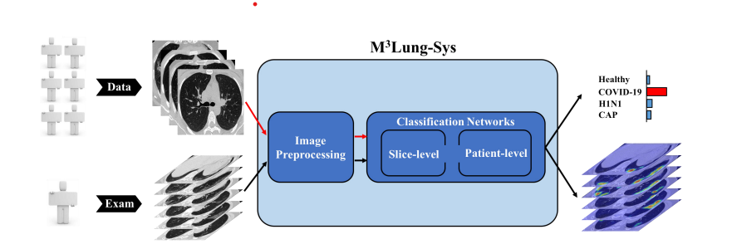
M3Lung-Sys: A Deep Learning System for Multi-Class Lung Pneumonia Screening from CT Imaging Xuelin Qian, Student Member, IEEE, Huazhu Fu, Senior Member, IEEE, Weiya Shi, Tao Chen, Member, IEEE, Yanwei Fu∗ , Member, IEEE, Fei Shan∗ , and Xiangyang Xue∗ , Member, IEEE
The proposed system is a Multi-task Multi-slice Deep Learning System (M3Lung-Sys) for multi-class lung pneumonia screening from CT imaging, which only consists of two 2D CNN networks, i.e., slice and patient-level classification networks.
The former aims to seek the feature representations from abundant CT slices instead of limited CT volumes, and for the overall pneumonia screening, the latter one could recover the temporal information by feature refinement and aggregation between different slices.
Different from previous 3D CNN approaches, which incur a substantial training cost, the system utilizes two 2D CNN networks, i.e., slicelevel and patient-level classification networks, to handle the discriminative feature learning from the spatial and temporal domain, respectively More importantly, without any pixel-level annotation for training, the system is able to simultaneously output the lesion localization
According to the remarkable experimental results on 292 testing cases with multi-class lung pneumonia (102 healthy people, 96 COVID-19 patients, 41 H1N1 patients and 53 CAP patients), this system has great potential for clinical application.

Slide 10
Intelligent Pneumonia Identification From Chest X-Rays
With the use of deep learning algorithms, some notable developments in the field of medical diagnostics have been made over the past ten years.
The CXR datasets for pneumonia that are publicly available are very class-imbalanced, which means that there are more images in one class than there are in the other. Class imbalance has a significant impact on a classification system's accuracy.
In the current literature on pneumonia identification from CXR images is presented, and the contributions are.
Review and analysis of the usability, and goodness factors and computational complexity of the algorithms that were used for pneumonia identification
Review and analysis of the quality, usability, size, and class balance extent of the available CXR images datasets.
Discuss and provide a comparative analysis of the algorithms used for pneumonia identification.
This paper examines methods for dealing with unbalanced datasets as well as the size, usability, and quality of the available chest X-ray datasets.
Current literature has indicated that deep learning-based algorithms achieve the best results for pneumonia classification with an accuracy of 98.7%, a sensitivity of 0.99, and a specificity of 0.98.
W. Khan, N. Zaki and L. Ali, "Intelligent Pneumonia Identification From Chest X-Rays: A Systematic Literature Review," in IEEE Access, vol. 9, pp. 51747-51771, 2021, doi: 10.1109/ACCESS.2021.3069937.

Slide 11
Viral Pneumonia Screening on Chest X-rays Using Confidence-Aware Anomaly Detection
The paper proposes a CAAD model for detecting viral pneumonia using chest X-rays.
The authors formulate the task as a one-class classification-based anomaly detection problem, which improves the model's performance in the presence of novel mutated viruses.
The CAAD model outperforms binary classification models on the X-VIRAL dataset.This model achieves an AUC of 83.61% and sensitivity of 71.70% on the X-COVID dataset without fine-tuning.
The proposed model treats all known viral pneumonia cases as anomalies, improving the one-class model's performance, which is valuable for large-scale screening and epidemic prevention.

Slide 12
PROBLEM STATEMENT
Our main motive is to detect Pneumonia.Deep learning is an important artificial intelligence tool, which plays a crucial role in solving many complex computer-vision problems. Deep learning models, specifically convolutional neural networks (CNNs), are used extensively for various image classification problems.

Slide 13
PROPOSED SYSTEM
The objective of Pneumonia detection is to detect the Pneumonia news in the patient records. In this work, the dataset containing the Pneumonia chest X-ray images will be taken into consideration. The pre-processing will be applied to the dataset and the noisy and null value data will be removed from the dataset. After that, the data will be analyzed and visualized for further processing. The machine learning algorithm will be chosen to make the prediction.

Slide 14
RESULTS
The project evaluation can be tested with the deep learning algorithm prediction results.
The accuracy score of the algorithm in the Pneumonia detection helps to evaluate the dataset.
The application will be developed with Google Colab Python Tool as the project can be directly executed in any type computer systems with internet connection.
There is no need of any specific softwares to be installed in the user system.
The machine learning algorithm libraries are built inside the Colab.

Slide 15
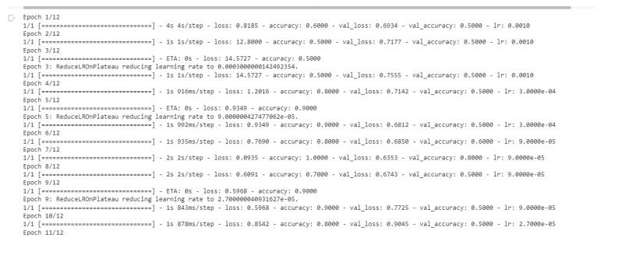
Finding the accuracy of the model:

Slide 16
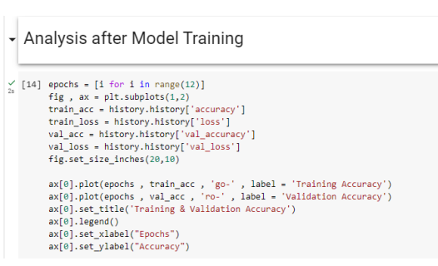
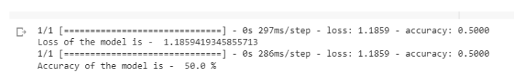
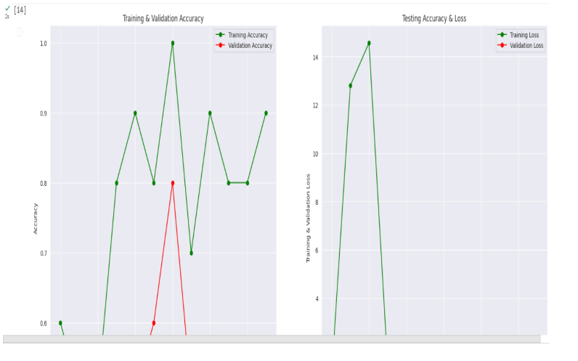
Results of accuracy:
The graph depicts the training accuracy with the validation accuracy of the convolutional neural network.

Slide 17
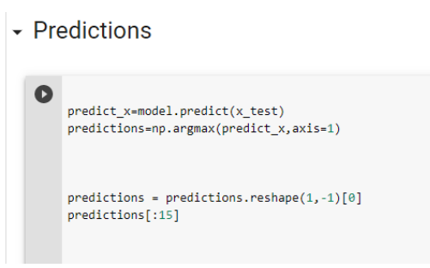
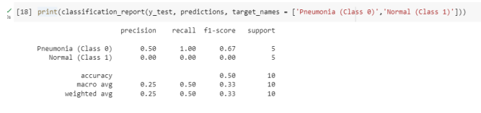
The predictions of the model are evaluated by bypassing the testing and training images of the dataset. The results of prediction results are displayed to show the precision, recall, f1-score, and support.

Slide 18
REFERENCES
[1]. Yaseliani, Mohammad & Zeinal Hamadani, Ali & Ijadi Maghsoodi, Abtin & Mosavi, Amir. (2022). Pneumonia Detection Proposing a Hybrid Deep Convolutional Neural Network Based on Two Parallel Visual Geometry Group Architectures and Machine Learning Classifiers. IEEE Access. 10. 10.1109/ACCESS.2022.3182498.
[2]. W. Khan, N. Zaki and L. Ali, "Intelligent Pneumonia Identification From Chest X-Rays: A Systematic Literature Review," in IEEE Access, vol. 9, pp. 51747-51771, 2021, doi: 10.1109/ACCESS.2021.3069937.
[3]. Zhang J, Xie Y, Pang G, Liao Z, Verjans J, Li W, Sun Z, He J, Li Y, Shen C, Xia Y. Viral Pneumonia Screening on Chest X-Rays Using ConfidenceAware Anomaly Detection. IEEE Trans Med Imaging. 2021 Mar;40(3):879- 890. doi: 10.1109/TMI.2020.3040950. Epub 2021 Mar 2. PMID: 33245693.
[4]. H. Ren et al., "Interpretable Pneumonia Detection by Combining Deep Learning and Explainable Models With Multisource Data," in IEEE Access, vol. 9, pp. 95872-95883, 2021, doi: 10.1109/ACCESS.2021.3090215.
[5]. M3Lung-Sys: A Deep Learning System for Multi-Class Lung Pneumonia Screening from CT Imaging Xuelin Qian, Student Member, IEEE, Huazhu Fu, Senior Member, IEEE, Weiya Shi, Tao Chen, Member, IEEE, Yanwei Fu∗, Member, IEEE, Fei Shan∗, and Xiangyang Xue∗, Member, IEEE

